Slide 1
From The Ecology of Language Evolution to Language Evolution: Contact, competition and change
Salikoko S. Mufwene
University of Chicago

Slide 2
Language Endangerment: From The Ecology of Language Evolution to date
… still an embarrassing subject matter for linguistics

Slide 3
Why an embarrassment?
We still appear to be more concerned with languages than with humans
We are still too focused on languages as representational systems than as tools or technology for communication
Too static a conception of “culture”!
We talk more about language rights than about human rights
There is still too much discourse about linguistic diversity for the good of linguistics

Slide 4
… socially,
Too much focus on language loss among Native Americans and other “indigenous” people as the abnormal case
… not enough interest in understanding why many people of European descent in the Americas, Australia, and New Zealand do not speak their heritage languages any more… and why they are projected as more normal citizens of the Americas, Australia and NZ than the “indigenous” people
And we should revisit the suggestion that Europe had/has no “indigenous” languages

Slide 5
… and intellectually:
Too little has been said about the place of language endangerment in language evolution and how it proceeds
The history on the subject matter is still shallow; too much focus on the European colonial period alone and on “globalization” too narrowly understood
There is still confusion between language documentation and language maintenance or revitalization

Slide 6
Politicians and economists are seeking our expert advice
What can linguists tell economists who need their expert opinions on socio-economic development?
What can linguists tell politicians about managing linguistic diversity or societal multilingualism and their (perceived) role in political conflicts?
What kind of political and economic ecologies can sustain linguistic diversity and to what advantage(s)?

Slide 7
Can linguists handle the subject matter alone?
How can we collaborate with economists in ways that are cross-fertilizing?
Languages as technology, as assets, as liabilities
Nations and population structure: the cost of being “minorated” and/or marginalized
The significance of urbanization and its role in sustaining or eroding the vitality of some languages.

Slide 8
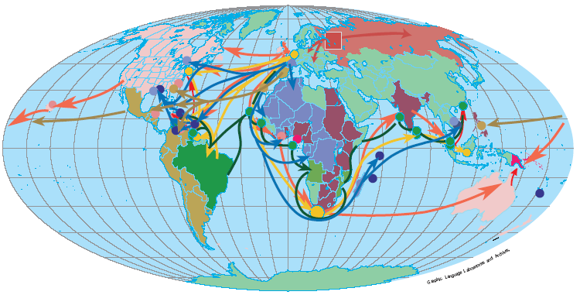
The current discourse on language endanger-ment and loss: Let’s blame it on colonization

Slide 9
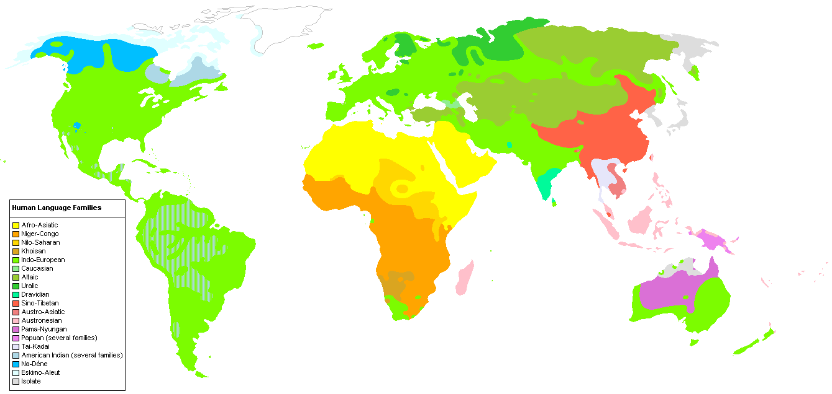
The linguistic/cultural Indo-Europeanization of the world since the 15th century… with some hybridization or innovations

Slide 10
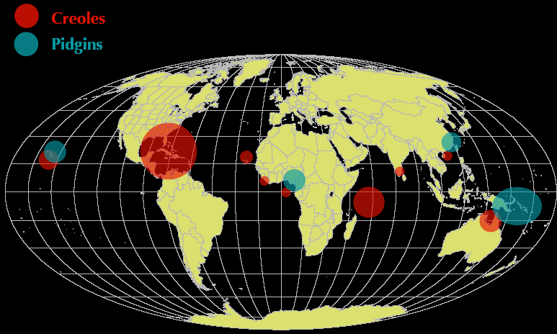
There have been not only losses but also some linguistic gains.

Slide 11
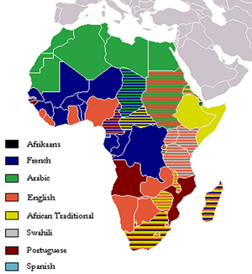
A partial post-colonial linguascape of Africa: Why hasn’t Africa Indo-Europeanized to the same extent as the Americas and Australia?

Slide 12
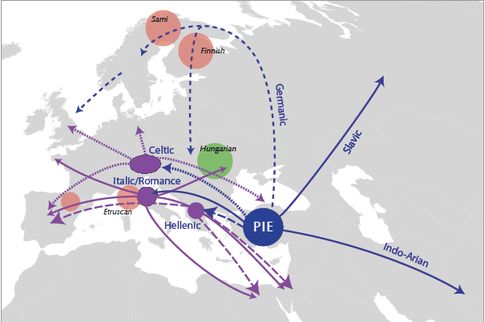
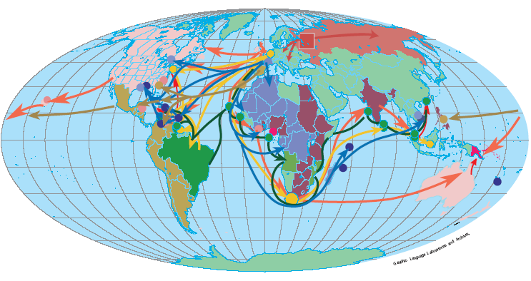
Language birth and death during the Indo-European expansion since about 6kya

Slide 13
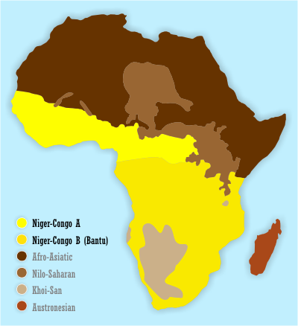
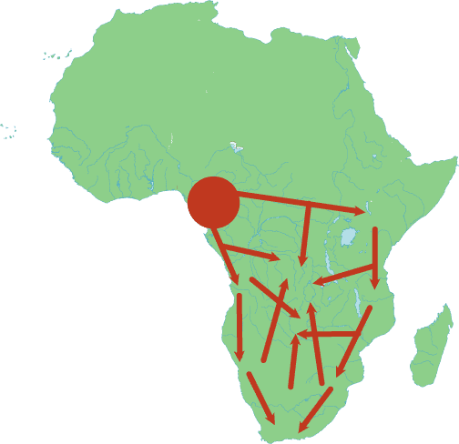
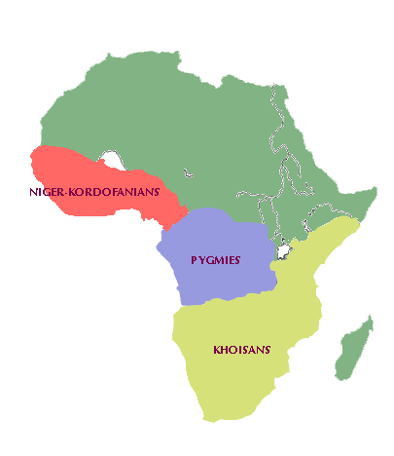
Bantu dispersal/migrations: A history of language births and deaths

Slide 14
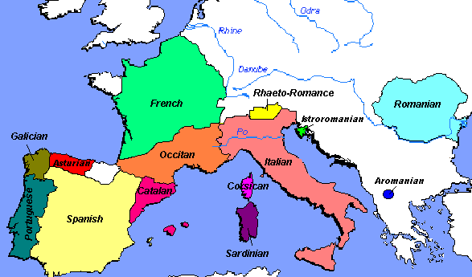
The Roman Empire and the emergence of the Romance languages

Slide 15
We can actually learn more about language vitality and/in the Roman Empire
A hybrid colonization style (according to my typology)
Varying language policies and practices
The significance of urban centers as spread points for Latin
Greater number of neo-Latin varieties
Locality of competition dynamics in lg evolution

Slide 16
Why has language vitality proceeded differ-entially? How variably has the Indo-European expansion proceeded?
Different colonization styles
Trade colonization
Settlement colonization
“Creolization” as linguistic/cultural indigenization
Exploitation colonization
The role of invaders’ ills in reducing indigenous populations
The role of indigenous migrations triggered my European settlements

Slide 17
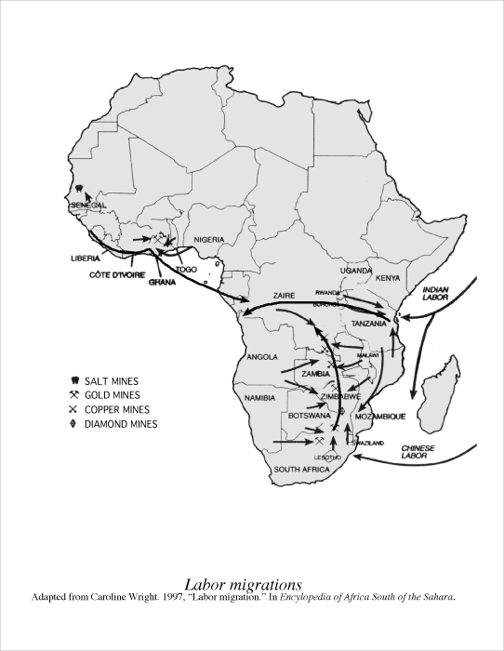
Migrations within Africa caused by the European colonization: Their impact on language evolution

Slide 18
Who said globalization had to be world-wide and uniform?
Globalization as:
Network of interconnectedness and interdependences
Integration
Population movements/migrations <=> Mobility with and without economic power
Glocalization and globalization index
Globalization and economic marginalization
Language and globalization

Slide 19
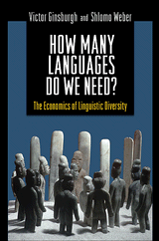
The role of language in the economic development of citizens and nations, and in international trade
Language and the reality of multiculturalism
Language and ethnic divisiveness
Language and eco-nomic integration or marginalization
Language and education

Slide 20
African cities: Interesting observatories for language contact and its consequences

Slide 21
Do linguists understand poverty and how to eradicate it in multilingual societies?
“La langue doit nourrire son homme”
Language as an asset or a liability
When “language wealth” and “language rights” mean nothing; and languages must be subordinated to people
Factoring the local econ-omic resources in the global picture.

Slide 22
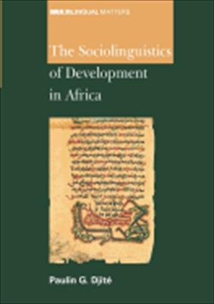
Empowering speakers economically in order to maintain/revitalize their languages
Can the State always af-ford to empower everyone of its languages?
Can the State exercise any control over the languages that individual citizens pre-fer to speak?
What kind of socioeconomic infrastructure should the State provide to help main-tain (ethno)linguistic diversity and equality?

Slide 23
How much control can a State exercise on individual decisions of its citizens regarding language practice?
Can the State control informal economy and how far?
Can the State control its citizens’ socializa-tion patterns?
Or can the State focus on developing the economic infrastructure ignoring patterns of language practice and probably disadvan-taging some people?
Or should the State leave it all to self-organization?

Slide 24
Who and/or what “kills” languages and how?
Do speakers really decide (consciously) to give up their languages?
What particular population structures favor evolution toward monolingualism?
Are the ecological conditions leading to language loss the same for all ethnolinguistic groups?
What particular kinds of ecological pressures determine individual speakers’ language choices during their interactions?
Why don’t speakers fight them if the pres-sures are disadvantageous? Or how can they (be advised to) fight them?

Slide 25
More concretely…
Why is English the dominant language of this conference and of the Summer School, while the French are our hosts?
Why am I talking to you in English when I am a fluent French speaker (or so I rate myself)?
Why didn’t I consider it an option to address you in Kikongo, or Lingala, or, least of all, Kiyansi and be a proud Muntu (*Bantu)?

Slide 26
So, from 2001 to date, regarding language endangerment and loss, linguists should realize that…
There is little that they can do themselves regarding language maintenance or revitalization ( language documentation).
They should expect (more) requests for advice from economists and politicians.
There are a lot of questions that we should be prepared to answer, based on sound empirical scholarship.
Language advocacy alone may yield more embarrassment than praise.

